Slide 1
Recap
array[row].length vs array[0].length
Matrix multiplication – element x element
Pass by value / reference

Slide 2
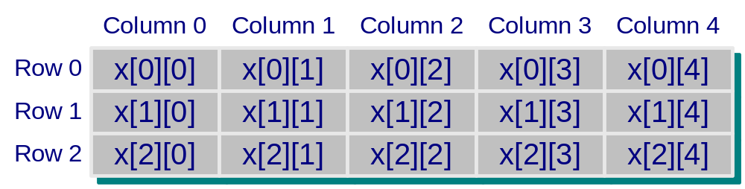

public static int sumOfRows(int[][] x) {
int row, column;
int sum=0;
for (row = 0; row < x.length; row++) {
for (column = 0; column < x[row].length; column++)
sum += x[row][column];
}
return sum;
}
public static int sumOfColumns(int[][] x) {
int row, column;
int sum=0;
for (column = 0; column < x[row].length; column++) {
for (row = 0; row < x.length; row++)
sum += x[row][column];
}
return sum;
}
}
x[row][column]
ar
0
Program Output
Sum of all elements in rows is 210
Sum of all elements in columns is 210
ar

Slide 3
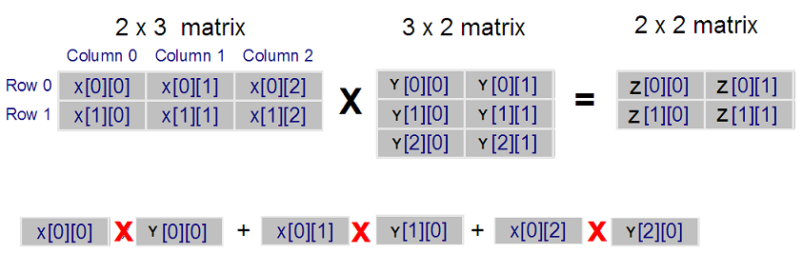

Matrix Multiplication
X[2][3]
Y[3][2]
Z[2][2]
Row_{x} 0 x Column_{Y} 0
for (l = 0; l < X.length; l++) // X rows
for (m = 0; m < Y[0].length; m++)//Y col
{
Z[l][m] = 0;
for (n = 0; n < X[0].length; n++)
Z[l][m] += X[l][n] * Y[n][m];
}

Slide 4
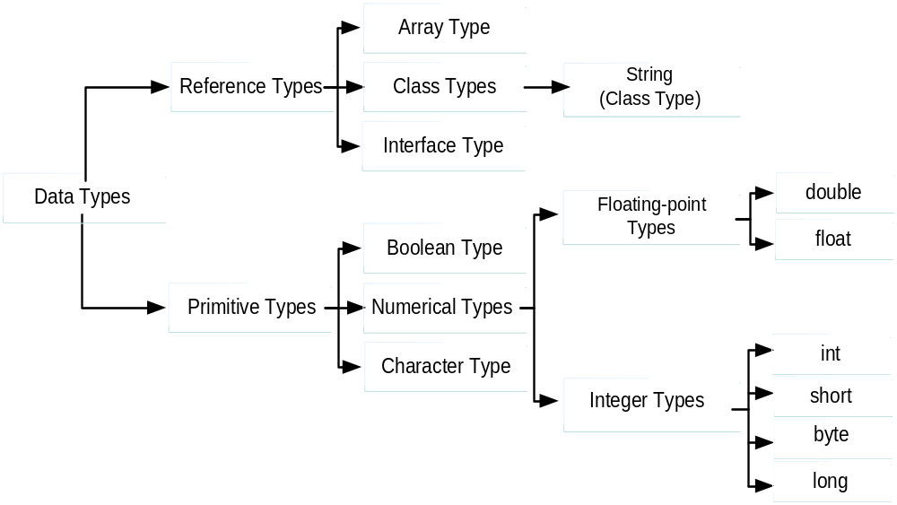
FROM LECTURE 3
Data Types

Slide 5
Pass by Value
Actual parameter : numArray
Formal parameter: value
{
……………
int[] numArray = new int[5];
for (index = 0; index < 5 ; index++)
numArray[index] = index ;
int val = add5( numArray[3] ); // pass indexed variable
System.out.println("The value returned is " + val);
System.out.println("The value of numArray[3] is " + numArray[3]);
}
public static int add5(int value) {
value += 5 ;
return value ;
}
}
…..
0
0
0
0
0
…
…..
0
1
2
3
4
…
Addr
1000
[0]
[1]
[2]
[3]
[4]
numArray
1000
Pass value over ,
value = numArray[3]
value
3
8
numArray[3]
(actual)
remains
unchanged
val
The value returned is 8
8
The value of numArray[3] is 3

Slide 6
Pass by Reference (memory addr)
Actual parameter : numArray
Formal parameter: ref
{
……………
int[] numArray = new int[5];
for (index = 0; index < 5 ; index++)
numArray[index] = index ;
add5( numArray ); // pass whole array
System.out.println("The value of numArray[3] is " + numArray[3]);
}
public static void add5(int[ ] ref ) {
for (int i = 0; i < ref.length ; i++)
ref[ i ] += 5 ;
}
}
…..
0
0
0
0
0
…
…..
0
1
2
3
4
…
…..
5
6
7
8
9
…
Addr
1000
[0]
[1]
[2]
[3]
[4]
numArray
1000
Pass reference over,
ref = numArray
ref
1000
numArray
(actual) changed
ref and numArray ‘see’ same data
The value of numArray[3] is 8

